Slide 1
Research Method

Slide 2

Contextual Inquiry
Contextual inquiry is a qualitative research method which involves observing people within their natural context (i.e, home, workplace, etc.) and interview them to fill the gaps of the observation
Contextual inquiry allows us to understand the attitude, behavior, interaction of people within their natural context

Slide 3
Contextual Inquiry
There are 4 key components of contextual inquiry:
Context: researcher has to conduct the research (observation, interview) in the natural location
Partnership/apprenticeship: researcher changes the role and become a listener where the participant becomes the expert
Interpretation: the observation must be interpretive by the participants, verify with participant, where participant are allowed to make changes
Focus: the researcher enter the field with a more narrow down focus.

Slide 4
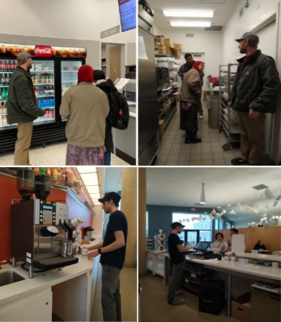
How Is It Done?
The researcher has to decide who the participant by asking who is currently doing the role in the context, next the researcher decides on the number of session
After the planning and narrowing down the focus the researcher recruit the participant who are doing the roles/work within the context of the research, then have a non-disruptive conversation
To wrap up show the participant the findings and ascertain it with the participant for transparency
Generated data:
Field notes,
photos,
recordings,
interview data,
artifacts,
physical traces

Slide 5
Contextual Inquiry
Pros
well suited when researchers aim to understand the experience of the participants within the natural context
It allows the researchers to understand the method of interaction as well as breakdown and transition

Slide 6
Contextual Inquiry
Pros
well suited when researchers aim to understand the experience of the participants within the natural context
It allows the researchers to understand the method of interaction as well as breakdown and transition
Cons
rigorous and time consuming. The method is very resource consuming
The role reversal of the participant during contextual inquiry from a passive to more active role sometimes create confusion for the participants
It may be impossible to control observational conditions due to the noise of other unrelated activities

Slide 7


Slide 8
In-class Activity

Slide 9
In-class activity
Sit with your group
Bring out the problem statement
Decide on what you want to explore or understand
What should be research questions?
Decide on which research methods to apply
Decide on who is your potential participants and how you plan to reach out to them
Finalize your research method
Finalize your questions (should prepare at least 6 to 7 high-level questions)
How long the data collection will take?
How do you capture the data (notes? video? photos?)
Where do you plan to store the collected data?

